Slide 1
IT306
Module 9
Collections and Generics

Slide 2
Recap: Map

Slide 3
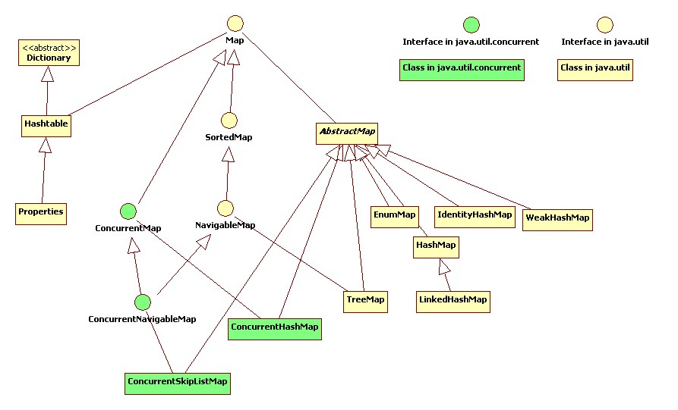
Recap: HashMap & Hashtable

Slide 4
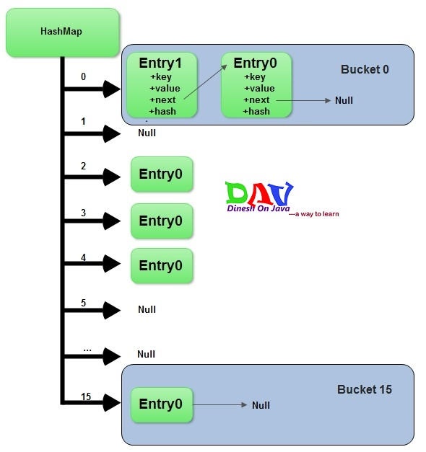
Recap: How does HashMap work Internally?
Remember: an entry is a key-value pair.
Step1: Calculate hashcode for key-value mapping.
Step2: Calculate position hashcode % (arrayLength-1) , where element should be placed. This is similar to bucket number.
Step3: Entries with duplicated keys are overwritten in hashmap.
Step4: A new entry is added to the bucket. If bucket has already at least one element, the new element gets added and placed in the first position in the bucket. Its next field refers to the old element. (Analogy: adding to the beginning of a LinkedList)
Array of buckets (array of pointers to multiple linkedlists)
Notes:
A hashmap is a simple, yet powerful way to store and access data.
Hashcode is used for key-value mapping. A hash function automatically calculates the hashcode for this mapping; hash value maps an entry to a bucket.
A Hashmap stores data into multiple unidirectional or singly linked lists of entries, called buckets. Each linkedlist represents a bucket so in that sense, a hashmap is an array of buckets or bins, where all keys with the same hash value are put in the same bucket or linked list. Therefore, entries are linked as in a singly linked list. This is demonstrated in this figure with an arrow from entry 1 for instance, to entry 2 where these are nodes of the Bucket 0 linked list.
Say this after “step 4”: Hashmap does not have order at any time, even when not rehashing.

Slide 5
Recap: Hash Function
Hash functions are primarily used in HashMaps and Hashtables, to quickly locate a data record (e.g., a dictionary definition) given its search key (the headword).
Hash function is used to map a search key to an index; the index gives the place in the HashMap where the corresponding record should be stored.
The domain of a hash function (the set of search keys) is larger than its range (the number of different table indexes)
It maps several different keys to the same index. Hence, each slot of a HashMap is associated with (implicitly or explicitly) a set of records, rather than a single record. For this reason, each slot of a HashMap is often called a “bucket”, and hash values are also called “bucket indices”.
Hashtable works in the similar way except slight differences explained later.
Goal of hash function, h, is to map each key k to an index in the range [0,N-1].
Study class HashMap<K,V>: http://docs.oracle.com/javase/7/docs/api/java/util/HashMap.html

Slide 6
Recap: HashMap Capacity
An instance of a HashMap has two parameters that affect its performance:
1) initial capacity ,
2) load factor.
Capacity is the number of buckets in the HashMap.
Initial capacity is the capacity at the time the HashMap is created.
Load factor is a measure of how full a HashMap is allowed to get before its capacity is automatically increased.
HashMap is open, i.e., in the case of a “hash collision”, a single bucket stored multiple entries must be searched sequentially.

Slide 7
Recap: HashMap Capacity
When initializing a HashMap such as:
HashMap<String, Integer> mapJdK = new HashMap<String, Integer>();
The Java implementation uses a default constant that represents the capacity of the hashmap:
DEFAULT_INITIAL_CAPACITY = 16;
DEFAULT_LOAD_FACTOR = 0.75;
THRESHOLD = DEFAULT_INITIAL_CAPACITY * DEFAULT_LOAD_FACTOR;
However, there is an overhead problem with this implementation due to the rehashing function: the Java implementation has to resize the number of buckets with the increasing number of data in the HashMap. To fix this, we can use the following formula if the size of data is approximately known in advance:
int capacity = (int) ((expected_maximal_number_of_data)/0.75+1);
HashMap<String,Integer> mapJdK = new HashMap<String,Integer>(capacity);
For small hashmaps there is no big difference, but for situations with really large hashmaps (e.g. 100 MB size) it can seriously increase the required memory, and the rehashing causes a slowdown of the application.
$$minimal initial capacity= \frac{number of data records}{0.75}+1$$
Notes:
Capacity is the number of buckets in the hashtable.
Initial capacity is the capacity at the time the hashtable is created.
Load factor is a measure of how full a hashtable is allowed to get before its capacity is automatically increased.

Slide 8
Recap: Hashtable vs. HashMap
Hashtable | HashMap
Does not allow null values | Allows null values
Supports key-value pair | Supports key-value pair
No ordering | No ordering
Does not allow duplicates | Does not allow duplicates
No upper bound | No upper bound
Synchronized | Unsynchronized
Members of Java Collection | Members of Java Collection
Synchronized means only one thread can modify a Hashtable at one point of time. Basically, it means that any thread before performing an update on a Hashtable will have to acquire a lock on the object while others will wait for lock to be released.

Slide 9
Recap: Social Media Example
public class User {
private String username;
private int userid;
private String phoneNumber;
private static int total;
public User(String username){
this.username= username;
total++;
userid=total;
}
public boolean setPhoneNumber(String phone){
if(phone.length()!=10) return false;
for(int i=0; i<phone.length(); i++){
if(!Character.isDigit(phone.charAt(i))) return false;
}
this.phoneNumber=phone;
return true;
}
public String getUsername(){ return username; }
public int getUserid() { return userid; }
public static int getTotal(){ return total; }
public String getPhoneNumber() {return phoneNumber; }
public String toString(){
return "Username: " + this.username + "\nUserid: "+this.userid + "\nphone number: "+ this.phoneNumber;
}}
A social media site typically relies on a ( nonnumeric) username as a key that can be efficiently mapped to a particular user’s associated information.

Slide 10
Recap: Social Media Example
import java.util.*;
import java.util.Map.Entry;
import javax.swing.JOptionPane;
public class SocialMediaUserApplication {
public static void main(String[] args) {
Map<String,User> all = new HashTable<String, User>();
User newUser = null;
while(JOptionPane.showConfirmDialog(null, "Add another user?")==JOptionPane.YES_OPTION){
newUser= getInput();
all.put(newUser.getUsername(),newUser);
}
System.out.println("Printing the content...");
displayAll(all);
System.out.println("\n\nRemoving the content....");
remove(all);
displayAll(all);
}
A social media site typically relies on a ( nonnumeric) username as a key that can be efficiently mapped to a particular user’s associated information.

Slide 11
Recap: Social Media Example
A social media site typically relies on a ( nonnumeric) username as a key that can be efficiently mapped to a particular user’s associated information.
public static User getInput(){
User user= new User(JOptionPane.showInputDialog("Enter a username."));
String phoneNumber="";
do{
phoneNumber=JOptionPane.showInputDialog("Enter a 10 digit phone number (XXXXXXXXXX)");
}while(!user.setPhoneNumber(phoneNumber));
return user;
}
public static void displayAll(Map<String, User> all){
Iterator it = all.entrySet().iterator();
while(it.hasNext()){
System.out.println( ((Entry<String, User>)it.next()).getValue().toString() +"\n");
}
}
public static void remove(Map<String, User> all){
String key = JOptionPane.showInputDialog("Enter a username to remove.");
if(all.containsKey(key))
all.remove(key);
}
}

Slide 12
Outline
Generic Programming
Java Collection Framework
Important Interfaces in Java

Slide 13
Generic
Programming

Slide 14
Non-Generic Type
public class Box {
private Object object;
public void set(Object object) { this.object = object; } public Object get() { return object; }
}
Notes:
Since its methods accept or return an Object, you are free to pass in whatever you want, provided that it is not one of the primitive types. There is no way to verify, at compile time, how the class is used. One part of the code may place an Integer in the box and expect to get Integers out of it, while another part of the code may mistakenly pass in a String, resulting in a runtime error.

Slide 15
Generic Types
A generic type is a generic class or interface that is parameterized over types.
Generic class:
class name<T1, T2, ..., Tn> { /* ... */ }
//T stands for Type
/**
* Generic version of the Box class.
* @param <T> the type of the value being boxed
*/
public class Box<T> {
private T t;
public void set(T t) { this.t = t; } public T get() { return t; }
}
Notes:
The type parameter section, delimited by angle brackets (<>), follows the class name. It specifies the type parameters (also called type variables) T1, T2, ..., and Tn.
A type variable can be any non-primitive type you specify: any class type, any interface type, any array type, or even another type variable.

Slide 16
Java Generics T vs Object
With Generic Type:
Box<Foo> b = new Box<Foo>();
Foo f = b.get();
With Object:
Box b = new Box();
Foo f= (Foo) b.get();
no need of casting (the compiler hides this from you)
compile time safety that works. If the Object version is used, you won't be sure that the method always returns Foo. If it returns Bar, you'll have a ClassCastException, at runtime.

Slide 17
Generic Programming
Generic Programming Is the creation of programming constructs that can be used with many different types.
Example: ArrayList<E>
ArrayList<String> stringList = new ArrayList<String>();
ArrayList<Character> characterList = new ArrayList<Character>();
ArrayList<Course> courseList = new ArrayList<Course>();
ArrayList<Item> inventory= new ArrayList<Item>();
…
When declaring a generic class, you supply a variable for each type parameter. For e.g., ArrayList<E> class declares methods
public void add(E element)
public E get(int index)
You could use another name instead of E. However, it is customary to use short, uppercase names for type parameters.
In order to use a generic class, you need to instantiate the type parameter. E.g.,
ArrayList<BankAccount> accounts= new ArrayList<BankAccount>();
Notes:
Angle bracket

Slide 18
Writing a Generic Class
public class GenericClassName<E> {
private E data;
. . .
}
Check package Lecture10.GenenricNode:
GenericNode.java
Student.java
GenericNodeApplication.java

Slide 19
GenericNode.java
public class GenericNode<E> implements Cloneable{
E data;
GenericNode<E> next;
public GenericNode (E data , GenericNode<E> next){
this.data = data;
this.next = next;
}
public void setNext(GenericNode<E> next){this.next = next;}
public E getData(){ return data; }
public boolean hasNext() { return (next!=null)?true:false; }
public GenericNode<E> getNext() { return next; }
public GenericNode<E> clone(){
GenericNode<E> answer;
try {
answer = (GenericNode<E>) super.clone();
} catch (CloneNotSupportedException e) {
throw new RuntimeException ("This class does not implement Cloneable");
}
return answer;
}
}

Slide 20
Student.java
public class Student {
private String name;
private String major;
public Student(String name, String major) {
this.name = name;
this.major = major;
}
public String getName() { return this.name; }
public String getMajor() { return this.major; }
public String toString() { return "name: "+ name + ", major: " + major; }
}

Slide 21
GenericNodeApplication.java
public class GenericNodeApplication {
public static void main(String[] args) {
GenericNode<Student> s1 = new GenericNode<Student>(
new Student("Tom Jones" , "IT") , null);
GenericNode<Student> s2 = new GenericNode<Student>(
new Student("Sara Dian" , "CS") , null);
GenericNode<Student> s3 = new GenericNode<Student>(
new Student("Nina Tran" , "CS") , null);
GenericNode<Student> s4 = new GenericNode<Student>(
new Student("Ye James" , "IT") , null);
s1.setNext(s2);
s2.setNext(s3);
s3.setNext(s4);
GenericNode<Student> s = s1;
do{
System.out.println(s.getData());
}while((s=s.getNext())!=null);
GenericNode<Student> clone = s1.clone();
System.out.println("\nClone Object: " + s1.getData());
}
}

Slide 22
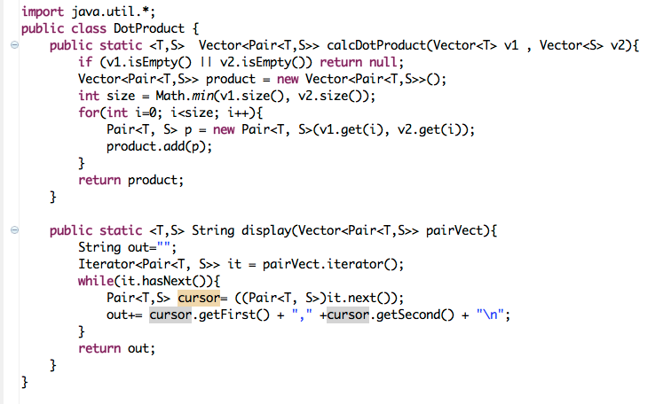
Generic Methods
Just like type declarations, method declarations can be generic, parameterized by one or more type parameters.

Slide 23
Comparing Reference Types
public class MyEntry implements Comparable<MyEntry>{
private String key;
private String value;
public MyEntry (String k, String v){
key = k;
value = v;
}
public void setKey(String k) { key = k; }
public void setValue(String v) {value = v; }
public String getKey() { return key; }
public String getValue() {return value; }
public int compareTo(MyEntry myNewEntry) {
if(newEntry.getKey().compareTo(key)<0) return -1;
else if (newEntry.getKey().compareTo(key)>0) return 1;
else return 0;
}
}

Slide 24
Comparing Generic Types
public class MyEntry<K extends Comparable<K>,V extends Comparable <V>>
implements Comparable<MyEntry<K,V>>{
private K key;
private V value;
public MyEntry (K k, V v){
key = k;
value = v;
}
public void setKey(K k) { key = k; }
public void setValue(V v) {value = v; }
public K getKey() { return key; }
public V getValue() {return value; }
public int compareTo(MyEntry<K,V> newEntry) {
if(newEntry.getKey().compareTo(key)<0) return -1;
else if (newEntry.getKey().compareTo(key)>0) return 1;
else return 0;
}
}

Slide 25
Java Collection Framework

Slide 26
Traditional Structures for Grouping Java Objects
Array
e.g., Student[] arr = new Student[10];
arr[some index]
Vector
e.g., Vector<Student> vec = new Vector<Student>();
vec.elementAt(some index)
Hashtable
e.g., Hashmap<String,Student> map = new Hashtable<String,Student>();
map.put(<student ID> , <student object> ), map.get(<student ID>)
Some of the problems with these data structures
Inconsistency in implementation due to the different syntax
No standard framework to manipulate these collections.
Solution: Java Collections Framework
Notes:
Before Collections made its most welcome debut, the standard methods for grouping Java objects were via the array, the Vector, and the Hashtable. All three of these collections have different methods and syntax for accessing members.
These differences have long led programmers down the path to inconsistency in implementing their own collections.
Another important issue: No implementation of a standard interface o help with developing algorithms such as sort, to manipulate these collections.
The complication can extend beyond this, however, it is out of the scope of this course.
Thankfully, the Java Collections Framework remedies these problems and offers a number of advantages over using no framework
Vector:The Vector class implements a growable array of objects. Like an array, it contains components that can be accessed using an integer index. However, the size of a Vector can grow or shrink as needed to accommodate adding and removing items after the Vector has been created.

Slide 27
Java Collections Framework
Collection is a single unit of objects. It is also called “container”.
Collections are used to store, retrieve, manipulate, and communicate aggregate data.
Java Collection framework provides
many interfaces like Set, List, Queue, etc.
many classes like ArrayList, Vector, LinkedList, PriorityQueue, HashSet, TreeSet, etc.
Notes:
A collections framework is a unified architecture for representing and manipulating collections.
All collections frameworks contain the following:
1) Interfaces: These are abstract data types that represent collections like Set. Interfaces allow collections to be manipulated independently of the details of their representation. Because In object-oriented languages, interfaces generally form a hierarchy.
2) Implementations: These are the concrete implementations of the collection interfaces. In essence, they are reusable data structures.
3) Algorithms: These are the methods that perform useful computations, such as searching and sorting, on objects that implement collection interfaces. The algorithms are said to be polymorphic: that is, the same method can be used on many different implementations of the appropriate collection interface.

Slide 28
Advantages of Java Collections Framework
Offering a set of collection interfaces: Collection, Set, List, or Map to simplify collection class methods
Enhance Coding, reduce programming effort, Promote software reuse
Enumeration technique by supporting Iterator that allows insert and delete operations
Support implicit ordering e.g., TreeSet and TreeMap
Improve the performance of large lists
Support for synchronization
Remedy to standard methods of grouping Java objects
Part of Core Java: java.util.collections
Notes:
With such standard framework, you ensure that your class conforms to a common template and becomes more regular and easily understood. So, whether you are implementing an SQL database, or a remote chat application, by implementing the Collection interface, the operations on your collection of objects are well-known to your users. Also the passing and returning of collections to and from class methods are simplified, and it allows the methods to work on a wider variety of collections.
As a result, the new collection implementation of Hashtable and Vector are added to implement a variety of collection interfaces, to name some : HashSet and TreeSet, ArrayList and LinkedList, Hashmap and Map. By employing such standard framework, your code can be shorter and quicker to download. Also, it will improve the performance of your code.
Increasing programming speed: this Collections Framework provides high-performance, high-quality implementations of useful data structures and algorithms. The various implementations of each interface are interchangeable, so programs can be easily tuned by switching collection implementations. Because you're freed from the burden of writing your own data structures, you'll have more time to devote to improving programs' quality and performance. Because it provides interoperability among urelated APIs, it reduces the programming effort of writing conversion code to connect to APIs.Fosters software reuse: New data structures that conform to the standard collection interfaces are by nature reusable. The same goes for new algorithms that operate on objects that implement these interfaces.
Other useful enhancements Each collection now returns an Iterator, an improved type of Enumeration that allows element operations such as insertion and deletion. The Iterator is "fail-fast," which means you get an exception if the list you're iterating is changed by another user.
You can sort other collections by providing a collection-compare method (a Comparator object) or an object-compare method (the Comparable interface).
You can find the smallest and largest elements or perform a binary search to improve the performance of large lists.
Finally, a static class Collections provides unmodifiable (read-only) and synchronized versions of existing collections. The unmodifiable classes are helpful to prevent unwanted changes to a collection. The synchronized version of a collection is a necessity for multithreaded programs.
The Java Collections Framework is part of Core Java and is contained in the java.util.collections package of JDK 1.2.

Slide 29
Collection Interface
A Collection represents a group of objects known as its elements.
Suppose, for example, that you have a Collection<String> c, which may be a List, a Set, or another kind of Collection. This idiom creates a new ArrayList (an implementation of the List interface), initially containing all the elements in c. List<String> list = new ArrayList<String>(c);
The Collection interface contains methods that perform basic operations, such as int size(), boolean isEmpty(), boolean contains(Object element), boolean add(E element), boolean remove(Object element), and Iterator<E> iterator().
It also contains methods that operate on entire collections, such as boolean containsAll(Collection<?> c), boolean addAll(Collection<? extends E> c), boolean removeAll(Collection<?> c), boolean retainAll(Collection<?> c), and void clear().
Additional methods for array operations (such as Object[] toArray() and <T> T[] toArray(T[] a) exist as well.
The Collection interface does about what you'd expect given that a Collection represents a group of objects. It has methods that tell you how many elements are in the collection (size, isEmpty), methods that check whether a given object is in the collection (contains), methods that add and remove an element from the collection (add, remove), and methods that provide an iterator over the collection (iterator).

Slide 30
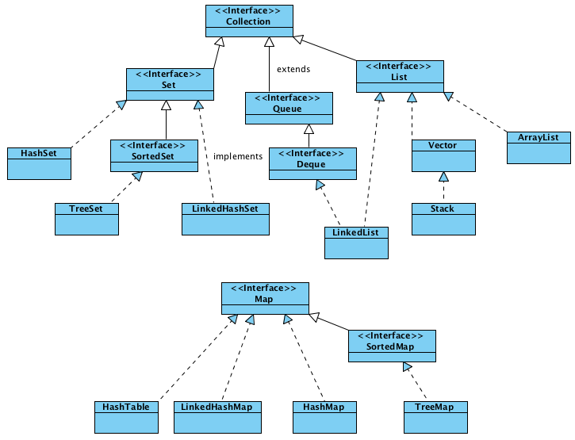
Interface Collection<E>
E - the type of elements in this collection
remove(int index)
set(int index, E element)
get(int index)
Additional method: toArray
Related Reading: https://docs.oracle.com/javase/7/docs/api/java/util/Collection.html
Notes:
The first advantage of the Java Collections Framework is a consistent and regular API. The API is codified in a basic set of interfaces, Collection, Set, List, or Map.
The Collection interface contains basic collection operations such as adding, removing, and tests for containment.
Any implementation of a collection, whether it is one provided by the Java Collections Framework or one of your own creations, will support one of these interfaces.
Both Set and List implement the Collection interface. The Set interface is identical to the Collection interface except for an additional method, toArray, which converts a Set to an Object array.
The List interface also implements the Collection interface, but provides many accessors that use an integer index into the list. For instance, get, remove, and set all take an integer that affects the indexed element in the list.
The Map interface is not derived from collection, but provides an interface similar to the methods in java.util.Hashtable. Keys are used to put and get values. Each of these interfaces are described in following code examples.
Several collections (TreeSet and TreeMap) implicitly support ordering. Use these classes to maintain a sorted list with no effort.

Slide 31
Collection Interface cont.
Add method
The add method is defined generally enough so that it makes sense for collections that allow duplicates as well as those that don't. It guarantees that the Collection will contain the specified element after the call completes, and returns true if the Collection changes as a result of the call. Similarly, the remove method is designed to remove a single instance of the specified element from the Collection, assuming that it contains the element to start with, and to return true if the Collection was modified as a result.
Traversing collections using
for-each structure
Iterators
aggregate operations (JDK8)

Slide 32
Collection Interface cont.
toArray methods are provided as a bridge between collections and older APIs that expect arrays on input.
Object[] a = c.toArray();
Bulk operations
containsAll — returns true if the target Collection contains all of the elements in the specified Collection.
addAll — adds all of the elements in the specified Collection to the target Collection.
removeAll — removes from the target Collection all of its elements that are also contained in the specified Collection.
clear — removes all elements from the Collection.
The addAll, removeAll, and retainAll methods all return true if the target Collection was modified in the process of executing the operation.

Slide 33
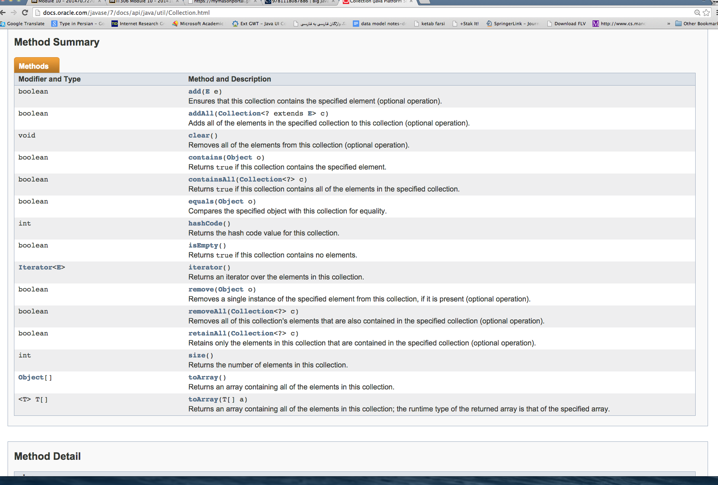
Collection Interface cont.

Slide 34
Interface Collection<E>
E - the type of elements in this collection
Related Reading: https://docs.oracle.com/javase/7/docs/api/java/util/Collection.html
Notes:
Lets see an example using HashSet collection.

Slide 35
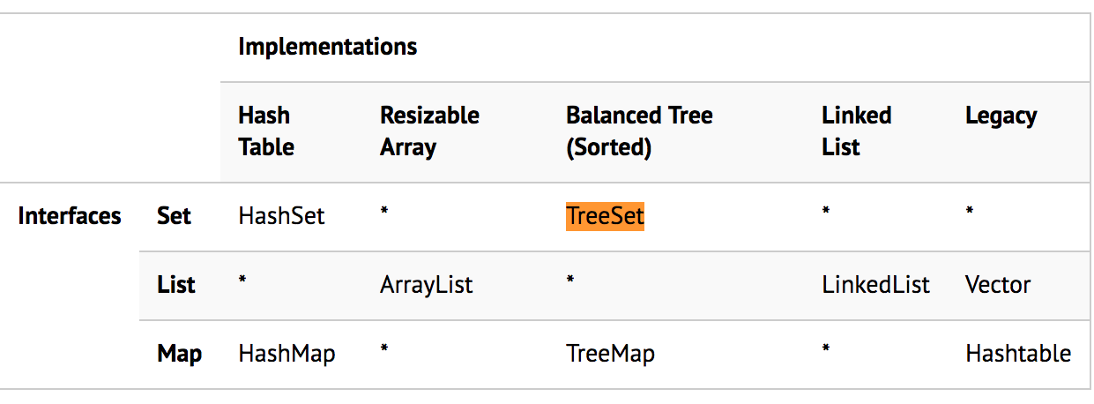
Implementation Differences within the Java Collection Framework
TreeSet
Notes:
Implementations marked with an asterix (*) make no sense or provide no compelling reason to implement. For instance, providing a List interface to a Hash Table makes no sense because there is no notion of order in a Hash Table. Similarly, there is no Map interface for a Linked List because a list has no notion of table lookup.

Slide 36
Example 1
import java.util.collections.*;
public class CollectionExample {
public static void main( String [ ] args ) {
// creatintg a collection
HashSet collection = new HashSet();
// Adding three elements to collection
String dog1 = "Max", dog2 = "Bailey", dog3 = "Harriet";
collection.add( dog1 ); collection.add( dog2 ); collection.add( dog3 );
// printing the size of collection
System.out.println( "Collection created" + ", size=" + collection.size() + ", isEmpty=" + collection.isEmpty() );
// checking containment
System.out.println( "Collection contains " + dog3 + ": " + collection.contains( dog3 ) );
// Enumeration
System.out.println( “Unsorted collection enumeration starts:" );
Iterator iterator = collection.iterator();
while ( iterator.hasNext() )
System.out.println( " " + iterator.next() );
// Removing elements
collection.remove( dog1 );
collection.clear();
} //end of method main
} //end of class CollectionExample
Related Reading: https://docs.oracle.com/javase/7/docs/api/java/util/HashSet.html
Notes:
This code segment demonstrates how to perform different Collection operations on HashSet, which is a basic collection that implements the Set interface.
A HashSet is simply a set that doesn't allow duplicate elements and doesn't order or position its elements.
The code shows how you create a basic collection and add, remove, and test for elements.

Slide 37
Exercise 1
import java.util.collections.*;
public class CollectionExample {
public static void main( String [ ] args ) {
// creatintg a collection
HashSet collection = new HashSet();
// Adding three elements to collection
String dog1 = "Max", dog2 = "Bailey", dog3 = "Harriet";
collection.add( dog1 ); collection.add( dog2 ); collection.add( dog3 );
// printing the size of collection
System.out.println( "Collection created" + ", size=" + collection.size() + ", isEmpty=" + collection.isEmpty() );
// checking containment
System.out.println( "Collection contains " + dog3 + ": " + collection.contains( dog3 ) );
// Enumeration
System.out.println( “Unsorted collection enumeration starts:" );
Iterator iterator = collection.iterator();
while ( iterator.hasNext() )
System.out.println( " " + iterator.next() );
// Removing elements
collection.remove( dog1 );
collection.clear();
} //end of method main
} //end of class CollectionExample
//TODO: Replace the “HashSet” declaration and constructor by “Vector” and test the code again.
Compare the result with that of the previous code.
Related Reading: https://docs.oracle.com/javase/7/docs/api/java/util/Vector.html
Notes:
Vector supports the Collection interface. Change this code so that you can execute this code on a vector. Complete this exercise by changing the HashSet declaration and constructor to a Vector.
So once you test the code, you will realize that both support the same set of operations because they both implement the operations supported by the collection interface.

Slide 38
Example 2
import java.util.collections.*;
public class CollectionExample {
public static void main( String [ ] args ) {
// creatintg a collection
ArrayList collection = new ArrayList();
// Adding three elements to collection
String[] dogs = { "Max", "Bailey”, "Harriet” };
collection.addAll(Arrays.asList(dogs));
// printing the size of collection
System.out.println( "Collection created" + ", size=" + collection.size() + ", isEmpty=" + collection.isEmpty() );
// Iteration using indexes
System.out.println( “Index-based Iteration starts:" );
for (int i=0; i< collection.size(); i++ )
System.out.println(collection.get(i)+ “\n”);
//Reverse Iteration using Iterator
System.out.println( “Iterator-based Iteration starts:" );
Iterator iterator = collection.iterator( collection.size() );
while ( iterator.hasNext() )
System.out.println( iterator.next() + “\n” );
// Removing elements
collection.remove(0);
collection.clear();
} //end of method main
} //end of class CollectionExample

Slide 39
Exercise 2
import java.util.collections.*;
public class CollectionExample {
public static void main( String [ ] args ) {
// creatintg a collection
ArrayList collection = new ArrayList();
// Adding three elements to collection
String[] dogs = { "Max", "Bailey”, "Harriet” };
collection.addAll(Arrays.asList(dogs));
// printing the size of collection
System.out.println( "Collection created" + ", size=" + collection.size() + ", isEmpty=" + collection.isEmpty() );
// Iteration using indexes
System.out.println( “Index-based Iteration starts:" );
for (int i=0; i< collection.size(); i++ )
System.out.println(collection.get(i)+ “\n”);
//Reverse Iteration using Iterator
System.out.println( “Iterator-based Iteration starts:" );
Iterator iterator = collection.iterator( collection.size() );
while ( iterator.hasNext() )
System.out.println( iterator.next() + “\n” );
// Removing elements
collection.remove(0);
collection.clear();
} //end of method main
} //end of class CollectionExample
//TODO: Use a “LinkedList”, and then “Vector”
instead of an “ArrayList”.

Slide 40
TreeSet
java.util.TreeSet;
TreeSet provides an implementation of the Set interface.
Uses a red-black tree for storage.
Objects are stored in sorted, ascending order.
Guarantees log(n) time cost for the basic operations (add, remove and contains).
Doesn't offer any tuning parameters for iteration performance.
Offers a few handy methods to deal with the ordered set like first(), last(), headSet(), and tailSet().
Guarantees duplicate-free collection of elements.
Unsynchronized.
Does not support adding null.
Self-Balancing feature.
Ordering: Red-Black Tree Algorithm (Add , then Balance)
Traversal: LrR (Left-Root-Right)
E - the type of elements maintained by this set
Notes:
The other concrete Set implementation is the TreeSet.
TreeSet provides an implementation of the Set interface that uses a tree for storage. Objects are stored in a sorted and ascending order.
A TreeSet keeps its elements ordered internally.
The tree is balanced, it's a red-black tree.
Elements added to the tree must be orderable.
Having a balanced tree guarantees a quick o(log n) search time at the cost of a more time-intensive insertion (and deletion).
Access and retrieval times are quite fast, which makes TreeSet an excellent choice when storing large amounts of sorted information that must be found quickly.
Unsynchronized means multiple concurrent threads can access the treeset and modify it, so synchronizing the access should be handled externally.

Slide 41
TreeSet Example
import java.util.*;
Public class TreeSetExample{
TreeSet<String> ts = new TreeSet<String>();
ts.add("C");
ts.add("A");
ts.add("B");
ts.add("E");
ts.add("F");
ts.add("D");
System.out.println(ts);
}
Self-balancing tree that keeps the tree balanced (with minimum height). Keeps the height small in the face of arbitrary number of insertions and deletions. This means that the minimum height of a tree with n nodes is floor(log2 n).
Add method uses a comparator that can be arbitrary adjusted.
In this case, elements are sorted in ascending order:
A, B, C, D, E, F
Notes:
Start with the root
Compare with the root, if it is smaller than root, process the left child, otherwise, process the right child.
To keep a tree balanced (minimum height), create a subtree using three nodes, and replace the root of the subtree with the position of the root of the old subtree.

Slide 42
Comparator
import java.util.Comparator;
public class CompareAscend implements Comparator<String>{
public int compare(String o1, String o2) {
if (o1.compareToIgnoreCase(o2)==0) return 0;
else if(o1.compareToIgnoreCase(o2) < 0) return 1;
else return -1;
}
}
import java.util.Comparator;
public class CompareDescend implements Comparator<String>{
public int compare(String o1, String o2) {
if (o1.compareToIgnoreCase(o2)==0) return 0;
else if(o1.compareToIgnoreCase(o2) < 0) return -1;
else return 1;
}
}

Slide 43
TreeSet Example
import java.util.*;
Public class TreeSetExample{
TreeSet<String> ts = new TreeSet<String>(new CompareAscend());
ts.add("C");
ts.add("A");
ts.add("B");
ts.add("E");
ts.add("F");
ts.add("D");
System.out.println(ts);
}
In this case, elements are sorted in ascending order:
A, B, C, D, E, F
Notes:
Start with the root
Compare with the root, if it is smaller than root, process the left child, otherwise, process the right child.
To keep a tree balanced (minimum height), create a subtree using three nodes, and replace the root of the subtree with the position of the root of the old subtree.

Slide 44
TreeSet Example
import java.util.*;
Public class TreeSetExample{
TreeSet<String> ts = new TreeSet<String>(new CompareDescend());
ts.add("C");
ts.add("A");
ts.add("B");
ts.add("E");
ts.add("F");
ts.add("D");
System.out.println(ts);
}
In this case, elements are sorted in descending order:
F, E, D, C, B, A
Notes:
Start with the root
Compare with the root, if it is smaller than root, process the left child, otherwise, process the right child.
To keep a tree balanced (minimum height), create a subtree using three nodes, and replace the root of the subtree with the position of the root of the old subtree.

Slide 45
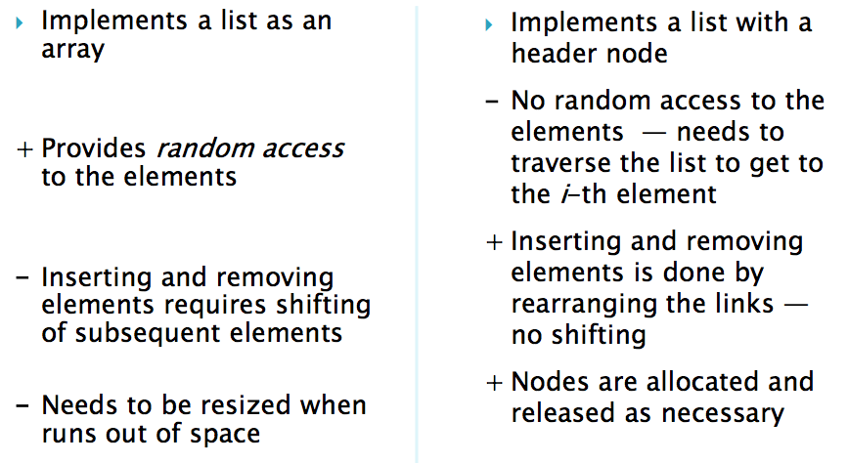
Other Collections
import java.util.ArrayList;
…
ArrayList<String> list = new ArrayList<String>();
list.add("Sam");
ArrayList<E>
LinkedList<E>
ArrayList<E>
LinkedList<E>
- Not synchrinized
- Uses Arrays with 50% growth.
Notes:
Vector is similar with ArrayList, but it is synchronized. ArrayList is a better choice if your program is thread-safe. Vector and ArrayList require space as more elements are added. Vector each time doubles its array size, while ArrayList grow 50% of its size each time.

Slide 46
ArrayList<E> Methods
Modifier and Type | Method | Description
boolean | add(E e) | Appends the specified element to the end of this list.
void | add(int index, E element) | Inserts the specified element at the specified position in this list.
boolean | addAll(Collection<? Extends E> c) | Appends all of the elements in the specified collection to the end of this list, in the order that they are returned by the specifies collection’s Iterator.
boolean | addAll(int index, Collection<? Extends E> c) | Inserts all of the elements in the specified collections into this list, starting at the specified position.
void | clear() | Removes all of the elements from this list.
Object | clone() | Returns a shallow copy of this ArrayList instance.
boolean | contains(Object o) | Returns true if this list contains the specified element.
E | get(int index) | Returns the element at the specified position in this list.
int | indexOf(Object o) | Returns true if this list contains no element.
Iterator<E> | iterator() | Returns an iterator over the element in this list in proper sequence.

Slide 47
Other Collections
Vector<E>
implements a dynamic array.
Useful if you don’t know the size the array in the beginning.
Synchronized (any method that touches the vector’s content is thread safe).
Uses Arrays.
Doubles the size of the array for dynamic growth.
Vector<String> list = new Vector<String>();
list.add("Tom");
list.addElement(new String("Jon"));
Iterator<String> it = list.iterator();
while(it.hasNext()) System.out.println(it.next());
list.remove(0);
list.remove(0);
Notes:
Vector is similar with ArrayList, but it is synchronized. ArrayList is a better choice if your program is thread-safe. Vector and ArrayList require space as more elements are added. Vector each time doubles its array size, while ArrayList grow 50% of its size each time.

Slide 48
Vector vs Arraylist
Vector | Arraylist
synchronized | Non-synchronized
Dynamic resizing, double growth | Dynamic resizing, half growth
Thread-safe, poor performance | Better performance than vector
Ordered collection class | Ordered collection class
Allows duplicate and null values | Allows duplicate and null values
Grows and shrinks automatically when overflow and deletion happens | Grows and shrinks automatically when overflow and deletion happens
Notes:
Synchronization: ArrayList is non-synchronized which means multiple threads can work on ArrayList at the same time. For e.g. if one thread is performing an add operation on ArrayList, there can be an another thread performing remove operation on ArrayList at the same time in a multithreaded environment, while Vector is synchronized. This means if one thread is working on Vector, no other thread can get a hold of it. Unlike ArrayList, only one thread can perform an operation on vector at a time.
Resize: ArrayList grow by half of its size when resized while Vector doubles the size of itself by default when grows.
Performance: ArrayList gives better performance as it is non-synchronized. Vector operations gives poor performance as they are thread-safe, the thread which works on Vector gets a lock on it which makes other thread wait till the lock is released.

Slide 49
Bag
A generalization of the notion of a set is that of a multiset or bag, which is similar to a set but allows duplicates.
Typical operations on bags:
contains(B , x): checks whether the element x is present (at least once) in the bag B.
is_sub_bag(B1,B2): checks whether each element in the bag B1 occurs in B1 (subset).
count(B, x): returns the number of times that element x occurs in bag B.
union(B1,B2)
ArrayBag.java

Slide 50
Important Interfaces in java
Iterable
Cloneable
Comparable
Comparator

Slide 51
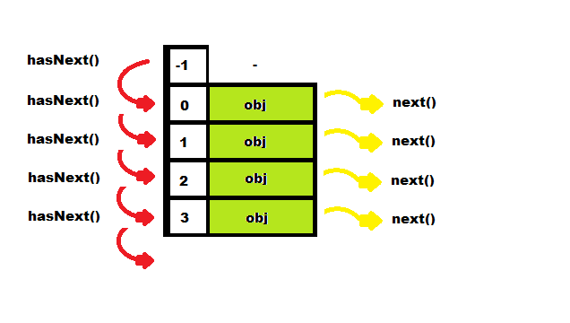
Interfaces and Iterators
Iterator<E> is a Java generic interface that depends on an unspecified class called E (generic type).
Any class that implements Iterable interface must have a method that returns an iterator with three methods hasNext, next, and remove.
An iterator steps through a sequence of elements, each of which is an E object.
Used for collections.
Notes:
An Iterable is a simple representation of a series of elements that can be iterated over. It does not have any iteration state such as a "current element". Instead, it has one method that produces an Iterator . An Iterator is the object with iteration state

Slide 52
Iterator Example
public class Student {
private String gnumber;
private double gpa;
public Student(String gnumber, double gpa) {
this.gnumber = gnumber;
this.gpa = gpa;
}
public String toString() {return "Gnumber: "+ this.gnumber + " , GPA: " + this.gpa; }
}

Slide 53
Iterator Example cont.
import java.util.*;
public class Test {
public static void main(String[] args) {
Student s1 = new Student("G123456", 3.4) , s2 = new Student("G123457", 3.2),
s3=new Student("G123458", 4.0),s4=new Student("G123459", 2.1), s5=new Student("G123410", 1.4);
Student[] all =new Student[] {s1, s2,s3,s4 ,s5};
Collection<Student> tr = new TreeSet<Student>();
tr = Arrays.asList(all);
Iterator it = tr.iterator();
while (it.hasNext()){
Student temp = (Student) it.next(); //CASTING is required!
System.out.println(temp);
}
}
}
Output:
Gnumber: G123456 , GPA: 3.4
Gnumber: G123457 , GPA: 3.2
Gnumber: G123458 , GPA: 4.0
Gnumber: G123459 , GPA: 2.1
Gnumber: G123410 , GPA: 1.4
Notes:
All collections support Iterable interface.

Slide 54
Interfaces and Iterators cont.
For ArrayBag.java
public class ArrayBag<E> implements Cloneable , Iterable<E>
import java.util.Iterator;
public class ArrayBagTester {
public static void main(String[] args) {
// TODO Auto-generated method stub
ArrayBag<Double> b1 = new ArrayBag<Double>();
b1.add(100.1);
b1.add(99.6);
b1.add(50.0);
b1.add(6.11);
ArrayBag<Double> b2 = new ArrayBag<Double>();
b2.add(100.1);
b1.add(699.6);
b1.add(150.0);
b1.add(86.11);
ArrayBag<Double> b3 = ArrayBag.union(b1, b2);
Iterator<Double> it = b3.iterator();
while(it.hasNext()) {
System.out.print(it.next() + ",");
}}}

Slide 55
Comparable Interface Example 1 : sorting based on name
public class Student implements Comparable<Student>{
private String name;
private double gpa;
public Student(String name, double gpa) {
this.name = name;
this.gpa = gpa;
}
public String getName() { return this.name; }
public doublegetGpa() { return this.gpa; }
public String toString() { return "name: "+ name + ", gpa: " + gpa; }
public int compareTo(Student o) { //to enablesorting based on “name”
return(this.name.compareToIgnoreCase(so.getName()));
}
}

Slide 56
Comparable Interface Example 1 : sorting based on name
import java.util.Iterator;
import java.util.TreeSet;
public class TestTreeSetOrder {
public static void main(String[] args) {
TreeSet<Student> tr = new TreeSet<Student>();
tr.add(new Student("A", 2.8));
tr.add(new Student("B", 4.0));
tr.add(new Student("C", 3.5));
tr.add(new Student("D", 1.0));
tr.add(new Student("E", 0.8));
tr.add(new Student("F", 2.2));
Iterator it = tr.iterator();
while(it.hasNext()){
System.out.println((Student)it.next());
}
}
}
Output:
name: A, gpa: 2.8
name: B, gpa: 4.0
name: C, gpa: 3.5
name: D, gpa: 1.0
name: E, gpa: 0.8
name: F, gpa: 2.2

Slide 57
Comparable Interface Example 2 : sorting based on GPA
public class Student implements Comparable<Student>{
private String name;
private double gpa;
public Student(String name, double gpa) {
this.name = name;
this.gpa = gpa;
}
public String getName() { return this.name; }
public doublegetGpa() { return this.gpa; }
public String toString() { return "name: "+ name + ", gpa: " + gpa; }
public int compareTo(Student o) { //to enablesorting based on “gpa”
if(this.gpa < o.getGpa()) return -1;
else if (this.gpa > o.getGpa()) return 1;
else return 0;
}
}

Slide 58
Comparable Interface Example 2 : sorting based on GPA
import java.util.Iterator;
import java.util.TreeSet;
public class TestTreeSetOrder {
public static void main(String[] args) {
TreeSet<Student> tr = new TreeSet<Student>();
tr.add(new Student("A", 2.8));
tr.add(new Student("B", 4.0));
tr.add(new Student("C", 3.5));
tr.add(new Student("D", 1.0));
tr.add(new Student("E", 0.8));
tr.add(new Student("F", 2.2));
Iterator it = tr.iterator();
while(it.hasNext()){
System.out.println((Student)it.next());
}
}
}
Output:
name: E, gpa: 0.8
name: D, gpa: 1.0
name: F, gpa: 2.2
name: A, gpa: 2.8
name: C, gpa: 3.5
name: B, gpa: 4.0

Slide 59
Comparator Interface: Example
Student.java
StudentComparator.java
Person.java

Slide 60
UML Diagram
Comparable
public abstract class Person {
private String name;
public Person(String name){ this.name = name;}
public String getName() { return name; }
public abstract String display();
}
Person
Student
Comparator
Student

Slide 61
Comparator Interface: Example– cont.
public class Student extends Person implements Comparable<Object>{
private double gpa;
public Student(String name, double gpa) { super(name); this.gpa = gpa; }
public double getGpa() { return this.gpa; }
public String toString() { return "name: "+ getName() + ", GPA: " + gpa; }
public int compareTo(Object o) {
if(! (o instanceof Student)) return -2;
else {
Student so= (Student) o;
return this.getName().compareToIgnoreCase(so.getName());
}
}
@Override
public String display() { return "Name: " +getName() + "; GPA: " + gpa;}
}
Notes:
Suppose we want sort students by their gpas and names also.
When we make a collection element comparable(by having it implement Comparable), we get only one chance to implement the compareTo() method.
The solution is using Comparator.
Unlike Comparable, Comparator is external to the element type we are comparing. It’s a separate class. We create multiple separate classes (that implement Comparator) to compare by different members.
Collections class has a second sort() method and it takes Comparator. The sort() method invokes the compare() to sort objects.

Slide 62
Comparator Interface: Example– cont.
import java.util.Comparator;
public class ComparatorByName implements Comparator<Student> {
public int compare(Student o1, Student o2) { return (o1.getName().compareToIgnoreCase(o2.getName());
}
}
Unlike Comparable, Comparator is external to the element type we are comparing. It’s a separate class.

Slide 63
Comparator Interface: Example– cont.
import java.util.Comparator;
public class ComparatorByGpa implements Comparator<Student> {
public int compare(Student o1, Student o2) {
if (o1.getGpa() < o2.getGpa()) return -1;
if (o1.getGpa() > o2.getGpa()) return 1;
else return 0;
}
}
Unlike Comparable, Comparator is external to the element type we are comparing. It’s a separate class.

Slide 64
Application.java
import java.util.*;
import javax.swing.JOptionPane;
public class CompareStudents {
public static void main(String[] args){
Set<Person> people= new TreeSet<Person>(new ComparatorByName());
String menu = "1- Add a student, 2- Display, 3- Exit.";
int option = -1;
while(true){
option = Integer.parseInt(JOptionPane.showInputDialog(menu));
switch(option){
case 1:
do{
people.add(getStudent());
}while(JOptionPane.showConfirmDialog(null, "Add more?")==JOptionPane.YES_OPTION);
break;
case 2:
displayAll(people);
break;
case 3:
System.exit(0);
break;
}
}
}

Slide 65
Application.java cont.
public static Person getStudent(){
return new Student(JOptionPane.showInputDialog("Enter student name") ,
JOptionPane.showInputDialog("Enter student major"));
}
public static void displayAll(Set<Person> all){
Iterator it = all.iterator() ;
String out= "";
if (!all.isEmpty()){
while(it.hasNext()){
out+= ((Person) it.next()).display() +"\n";
}
JOptionPane.showMessageDialog(null, out);
}
else JOptionPane.showMessageDialog(null, "The list is empty.");
}
}

Slide 66
Cloneable Interface
Clone is a shallow copy of an object.
public class GenericNode<E> implements Cloneable{
E data;
GenericNode<E> next;
public GenericNode (E data , GenericNode<E> next){
this.data = data;
this.next = next;
}
public void setNext(GenericNode<E> next){ this.next = next;}
public E getData(){ return data; }
public boolean hasNext() { return (next!=null)?true:false; }
public GenericNode<E> getNext() { return next; }
public GenericNode<E> clone(){
GenericNode<E> answer;
try {
answer = (GenericNode<E>) super.clone();
} catch (CloneNotSupportedException e) {
throw new RuntimeException(
"This class does not implement Cloneable");
}
return answer;
}
}

Slide 67
Lab 5 (Generic Programming)
/*
* a) Create a generic java class called "Combination.java" and write method "getPermutation" that produces
* a list containing all the ordered combinations (i.e., permutations) of two input vectors of generic types,
* using the Pair.java class.
* b) Display all the produced permutations using a display method in Combination.java class. The display
* method prints every pair (a,b) in the format <a,b>. Use Iterator to perform loop operation.
* Test these two methods using vectors v1 and v2 in ActivityApplication.java.
*
* hint: You can use DotProduct.java as extra help to complete this activity.
*/

Slide 68
References
TEXTBOOK
https://www.cs.auckland.ac.nz/software/AlgAnim/red_black.html
https://www.cs.usfca.edu/~galles/visualization/RedBlack.html
https://docs.oracle.com/javase/7/docs/

